Slide 1
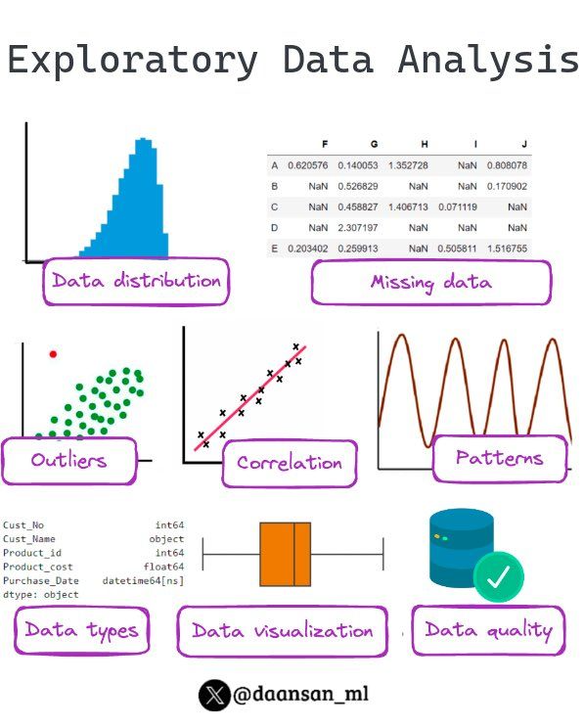
Data Science Mathematics
Probability
Probability enables understanding and interpreting data patterns, forming the basis for many analytical techniques in data science.
Linear Algebra Essentials
Linear algebra is crucial for handling multidimensional data, supporting algorithms in machine learning and modern analytics.
Notes:
Image source: Microsoft 365 content library Discover the foundational mathematical concepts that power data science. This presentation explores the essential topics, including statistics, linear algebra, and calculus, that underpin modern analytical techniques and machine learning methods. Gain insights into how mathematics shapes data-driven decision-making and innovation.

Slide 2
Why?
Data is most commonly numbers
Even when we don’t directly collect numbers, we have to use statistics to perform analysis
Mathematics gives us incredibly useful tools for understanding and modelling the world

Slide 3
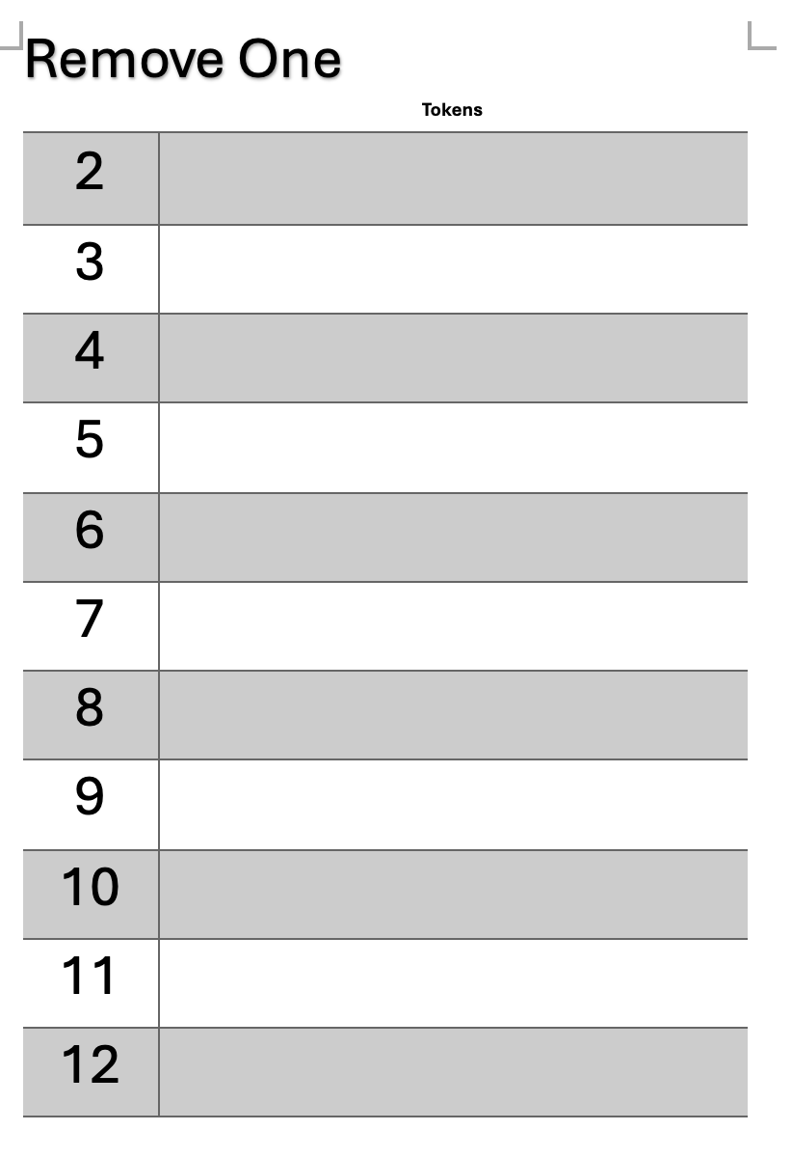
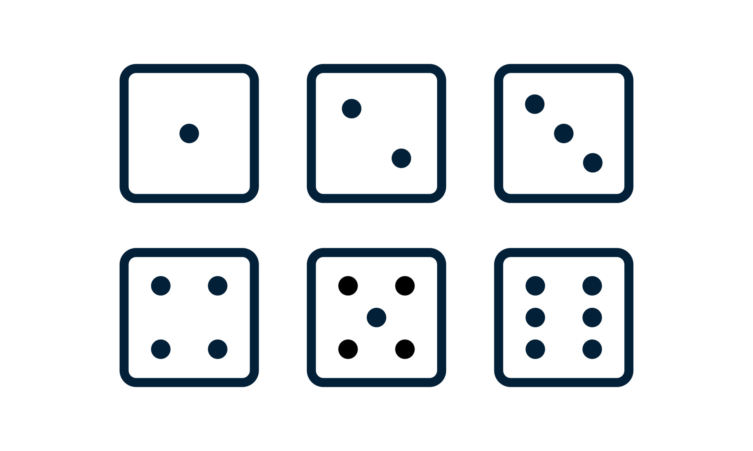
Probability Activity

Slide 4
Probability Activity
What’s the probability of a token placed on 2 being removed?
What’s the probability of a token placed on 7 being removed?
What’s the ideal token placement?

Slide 5
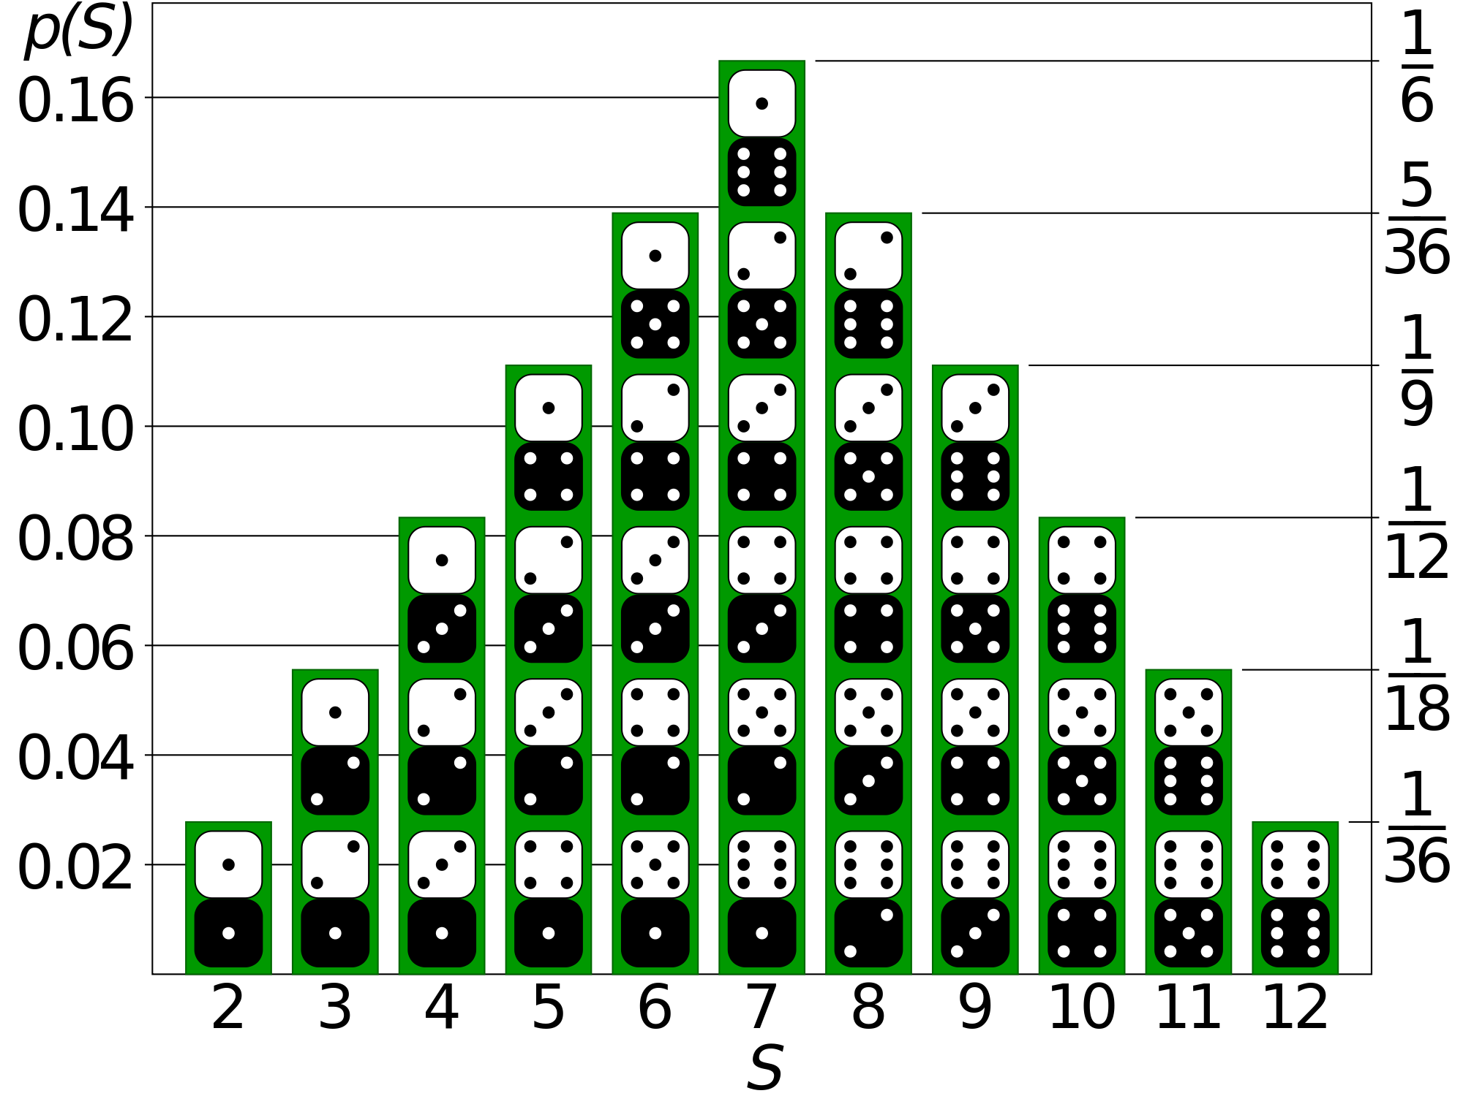
Probability Activity
Solution

Slide 6
Probability Notation
P(A) is the probability of event A happening
For example, A = the total of the dice being 6
P(A) should be between 0 and 1 with 0 being impossible and 1 being certain
P(A) + P(not A) should equal 1, i.e. the total chance of an event happening and not happening should be 1

Slide 7
Monty Hall Problem
Notes:
Let’s try this…
I have three doors, behind two of the doors there are goats and behind one of the doors there is a car. If you pick the door with the car behind it, then you win the car.
Now, the catch is that after you’ve made your choice, I’ll open up one of the other doors, afterwards you have a chance to swap to the remaining door or stay with your choice.
I’ll give you 10 minutes to discuss with your classmates, is it better to stay with your original choice or better to switch to the new door. No internet.

Slide 8
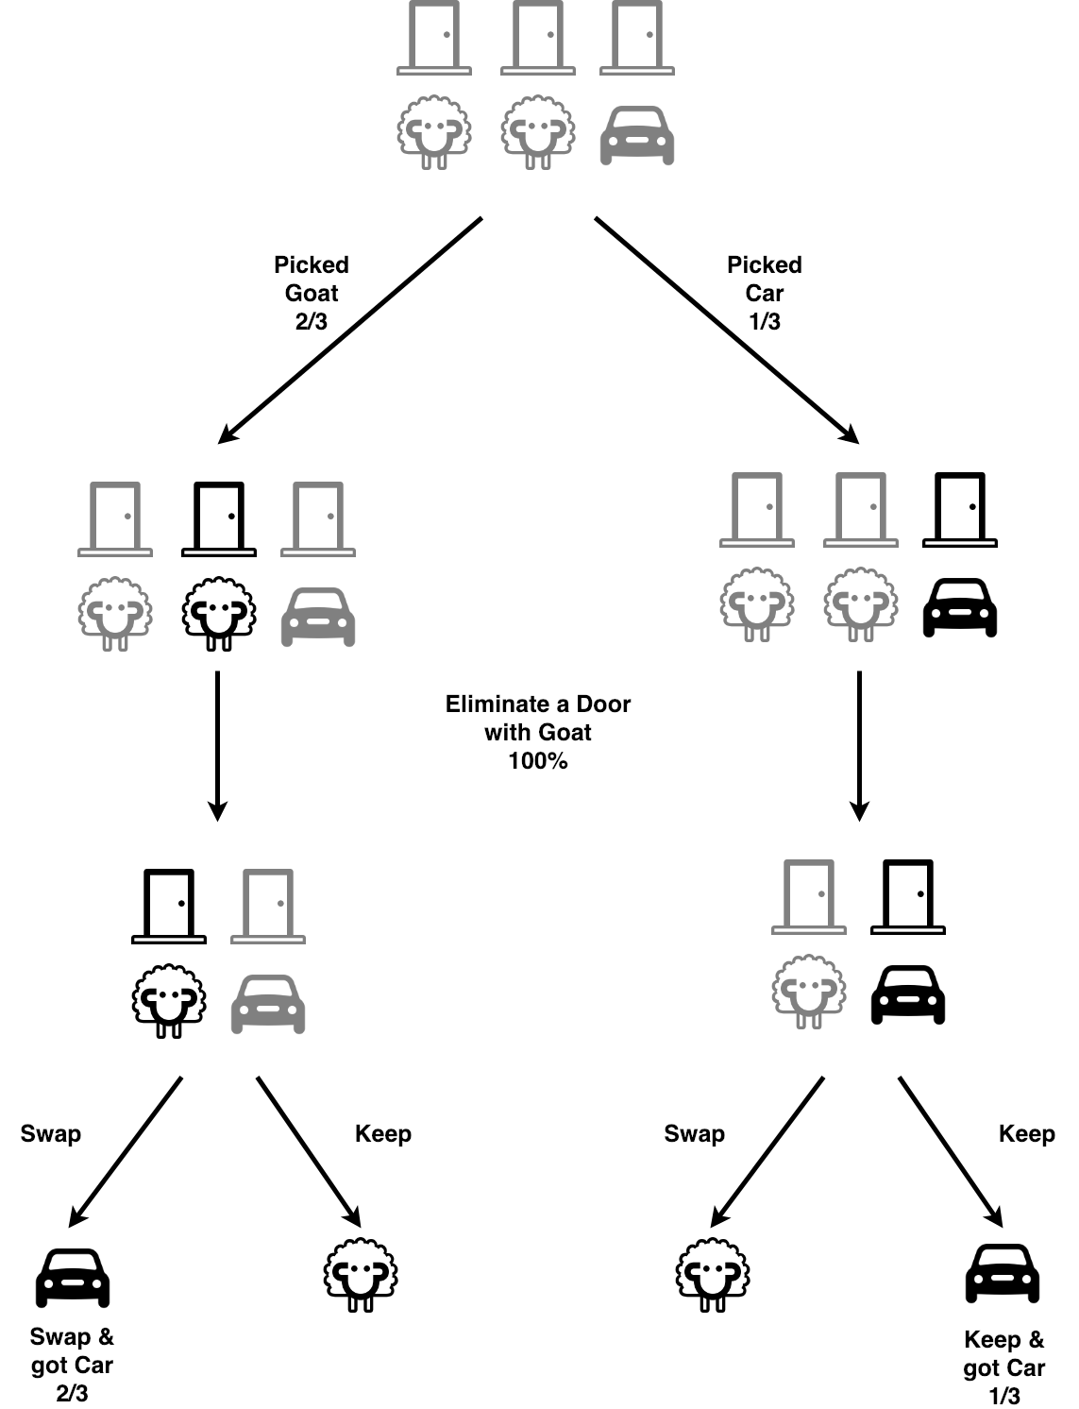
Monty Hall Problem
Let’s say the car is behind Door 1, and you pick:
a) You pick Door 1 (correct):
Monty chooses randomly between Door 2 and 3 (both goats).
You win if you stay (1/3 chance).
b) You pick Door 2 (goat):
Monty must open Door 3 (other goat).
Car is behind Door 1. You win if you switch.
c) You pick Door 3 (goat):
Monty must open Door 2 (goat).
Car is behind Door 1. You win if you switch.
In 2 out of 3 of these scenarios, Monty's hand is forced, and switching wins.

Slide 9


Bayes’ Law
How do we update our understanding when we see new data?
Bayes’ Law is a theorem that describes how to update the probability that a hypothesis is correct, given evidence.
$$P\left(H | E\right)=\frac{P\left(E | H\right)∙P(H)}{P(E)}$$
where
H = hypothesis (the car is behind the door you chose)
E = evidence (Monty opens a door to show a goat)
$$P\left(H | E\right)=\frac{P\left(E | H\right)∙P(H)}{P(E)} \\ P\left(H | E\right)=\frac{P\left(E | H\right)∙P(H)}{P\left(E | H\right)∙P\left(H\right)+P(E|notH)∙P(notH)} \\ P\left(H | E\right)=\frac{1∙\frac{1}{3}}{1∙\frac{1}{3}+1∙\frac{2}{3}}=\frac{1}{3}$$

Slide 10
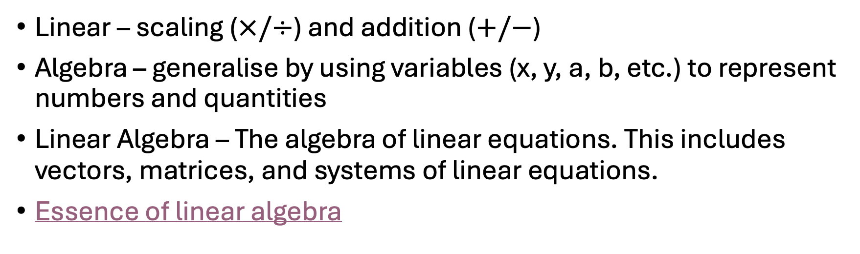
Linear Algebra
Linear – scaling ($×/÷$) and addition ($+/−$)
Algebra – generalise by using variables (x, y, a, b, etc.) to represent numbers and quantities
Linear Algebra – The algebra of linear equations. This includes vectors, matrices, and systems of linear equations.
Essence of linear algebra
Notes:
Linear algebra

Slide 11
Principle Component Analysis
What is PCA?
PCA is a way to simplify complex data.
Imagine you have a huge table of numbers — like test scores for students in 10 different subjects. It’s hard to look at so many numbers and see patterns. PCA helps you reduce the number of columns (features), while keeping the important information.

Slide 12


Principle Component Analysis
Real-Life Analogy: Taking a Picture from a Better Angle
Imagine we want to take a picture of the Hachiko statue in Shibuya. You want to take a picture that best shows what it looks like — so you move around and find the best angle.
PCA does that for data — it rotates the data and finds the best "angle" (direction) to view it from, so that:
The data is easiest to understand
Most of the important variation (differences) is visible

Slide 13
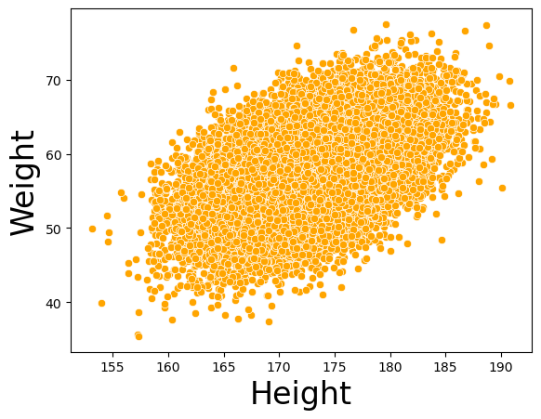
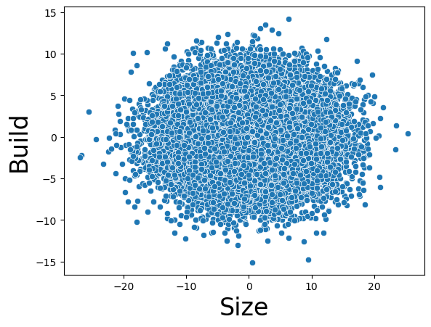
Principle Component Analysis
How It Works (Simple Idea)
Let’s say we have:
Height and weight for a bunch of students
If we draw this on a graph, taller students tend to weigh more, so the points form a kind of diagonal cloud. PCA finds that diagonal direction — the line that captures most of the "spread" of the data.
PCA Steps (Simplified):
Find the center of the data.
Rotate the axes to new directions that better fit the data.
Keep the most important directions, called principal components.
Throw away the less important ones, which don’t add much new info.

Slide 14
Principle Component Analysis
Why Use PCA?
To reduce the number of variables (e.g., from 10 down to 2 or 3).
To visualize complex data in 2D or 3D.
To remove noise and focus on the important patterns.

Slide 15
Principle Component Analysis
Example:
Imagine you have these features for fruits:
Length, width, weight, color shade, sweetness level
PCA might find:
The first component: "Size" (a mix of length, width, and weight)
The second component: "Flavor" (a mix of sweetness and color)
Now, instead of looking at 5 features, you just look at 2: Size and Flavor!

